Slide 1
Celebrating 75 Years of
Industrial Electron Microscopy
Paul Smith, Charles Herd, Ricky Magee
August 26th, 2016

Slide 2
Quick Outline
History of Electron Microscopy at Columbian Carbon / Columbian Chemicals / Birla Carbon
Microscopy for Rubber New Product Development (C. Herd)
Microscopy – A Practical Use (R. Magee)

Slide 3
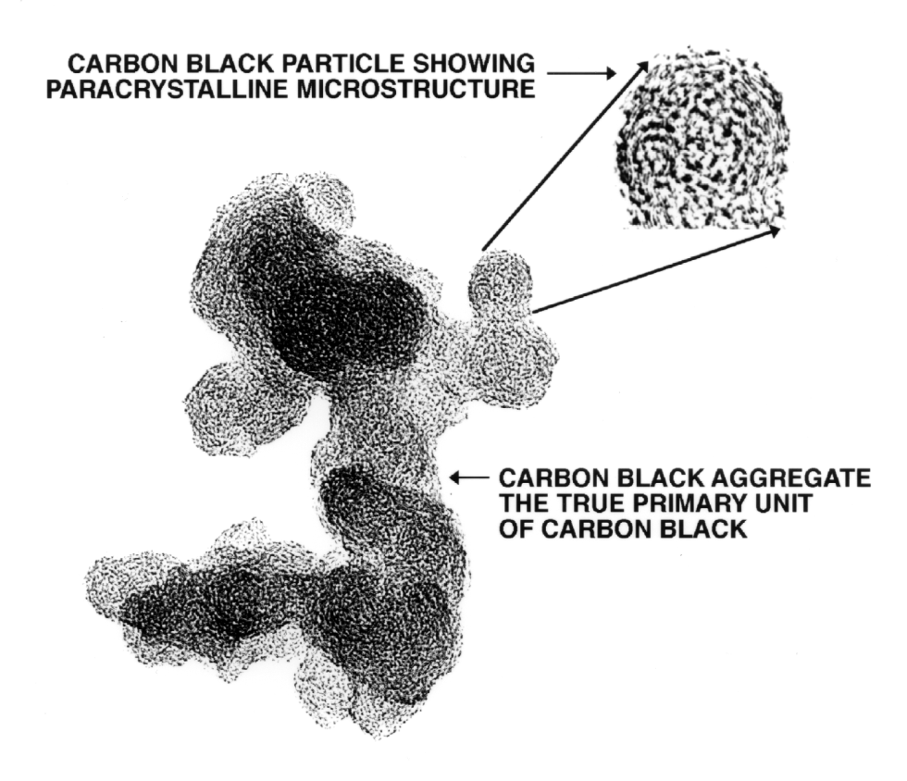
The Modern View of Carbon Black
Mean Particle Size
~ 8 to 100 nm
Mean Aggregate Size
~ 50 to 300 nm

Slide 4
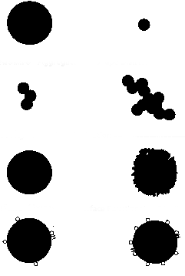
Size and Structure are Fundamental
Fineness
  Particle Size Distribution
Structure
  Aggregate Size/Shape Distribution
Porosity
  Pore Size Distribution
Surface Activity
  Surface Functionality Distribution

Slide 5
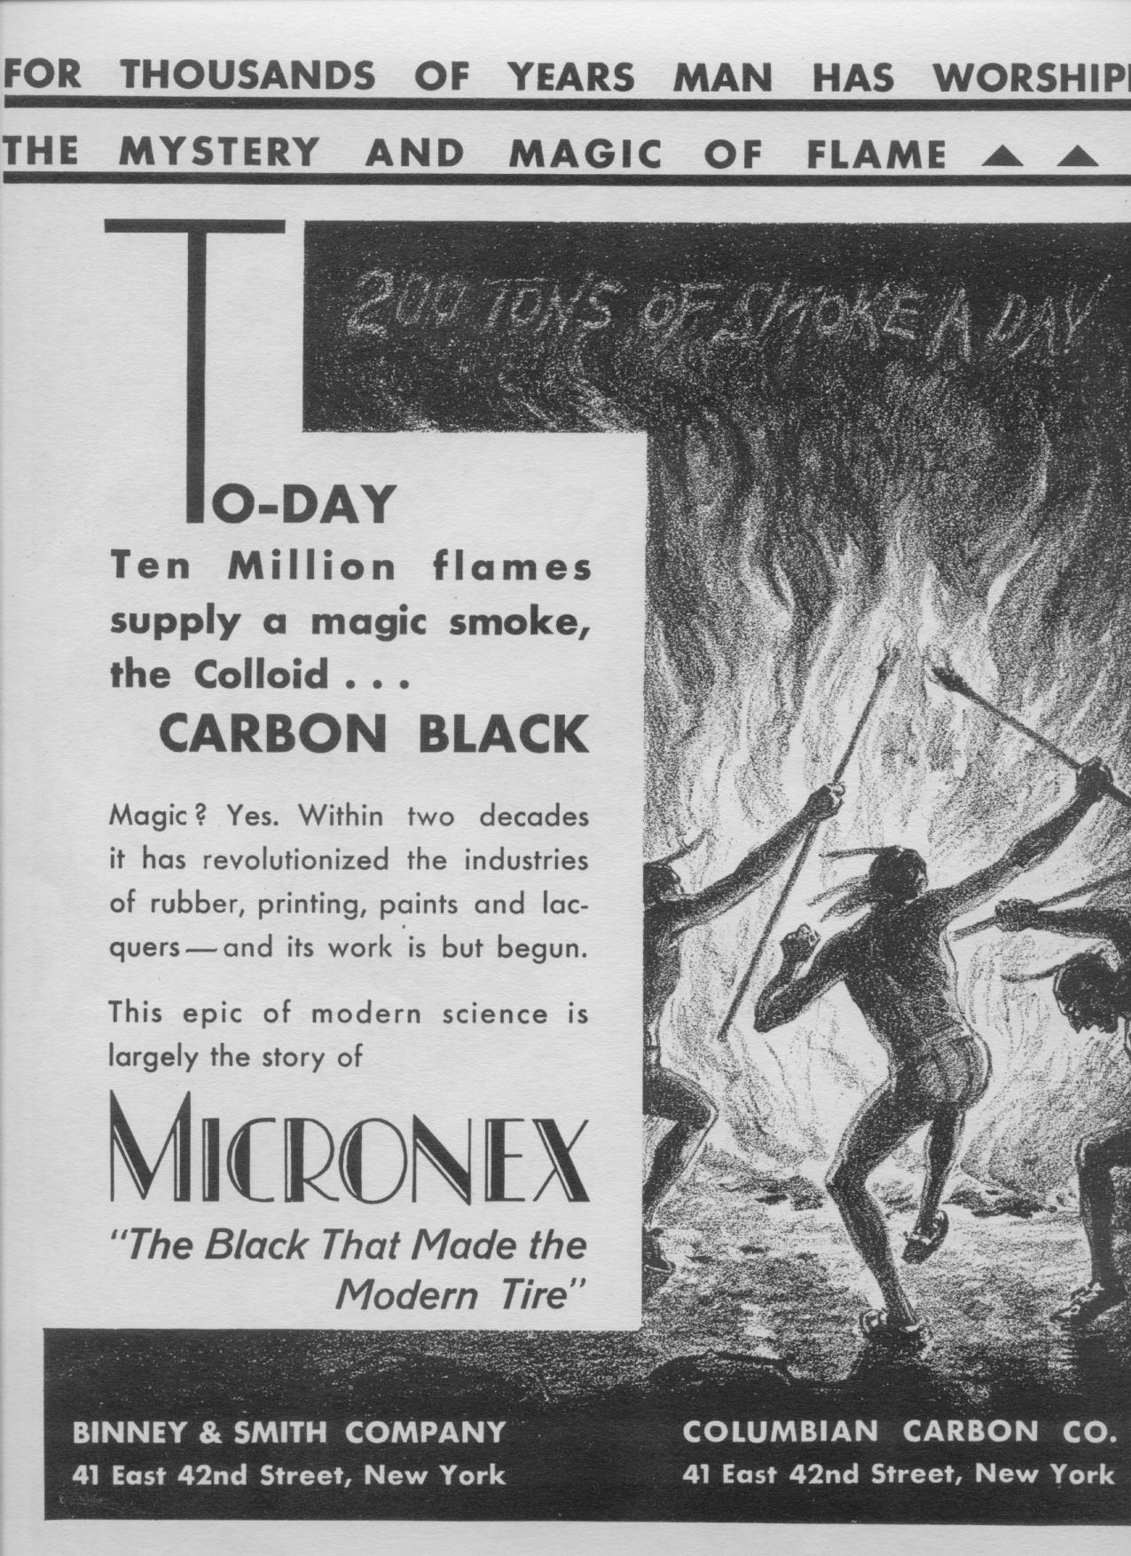
1931 Forbes Magazine Carbon Black advertisement
“Magic Smoke”
“200 Tons of Smoke a Day”
The truth was that they didn’t understand what carbon black really was!

Slide 6
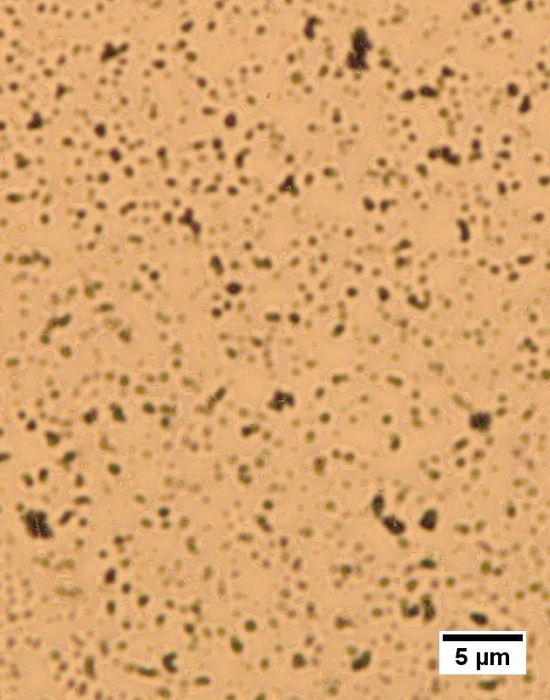
Carbon Black is So Small…
Until this point, characterization of carbon black is limited to Light Microscopy (LM)
But the LM resolution is insufficient to discriminate the CB aggregates
Can’t see CB even with the best light microscopes.

Slide 7
The Electron to the Rescue
A fundamental particle of electricity was discovered in 1897 and labeled as the “electron”
Through work before and after the “discovery” the mass and electric charge was determined for the electron
By the 1920’s the electron was understood well enough that it could be controlled via electromagnetic lenses
Realized that electrons under high voltage had a much smaller wavelength than visible light, more resolution!!
Electron Microscope!!!

Slide 8
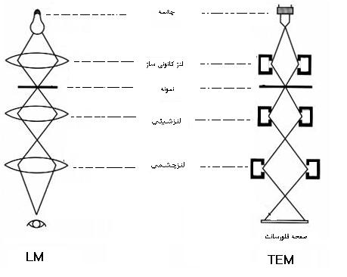
Electron Microscope Theory
Source
Objective
Sample
Condenser
Projector
e⁻ screen

Slide 9
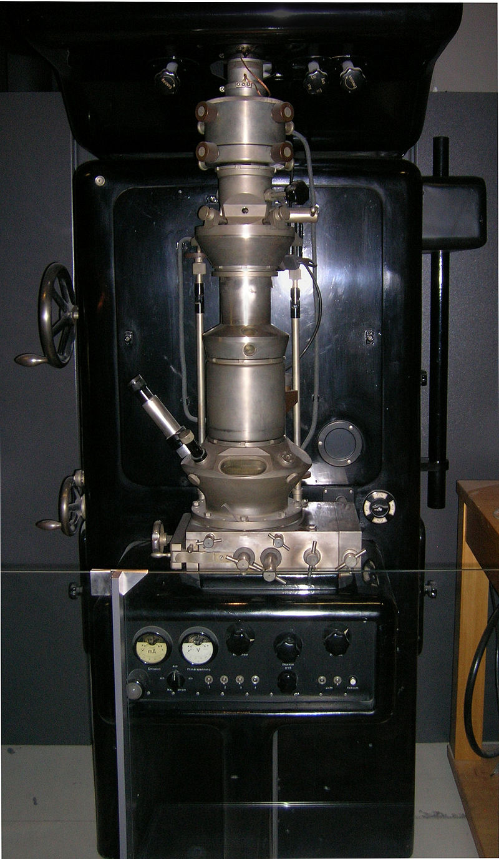
First Electron Microscope
German Physicist Ernst Ruska built the first prototype electron microscope in 1931 (only 400x)
Better than light microscope resolution in 1933
Was awarded the Nobel Prize for his work

Slide 10
University of Toronto
Prof. Eli Burton (Director of Physics at U. or Toronto) visits Ruska in 1934 and sees the EM
His group begins to build an EM in 1935
First model in 1935, but takes until 1938 to get an EM with sub optical resolution

Slide 11
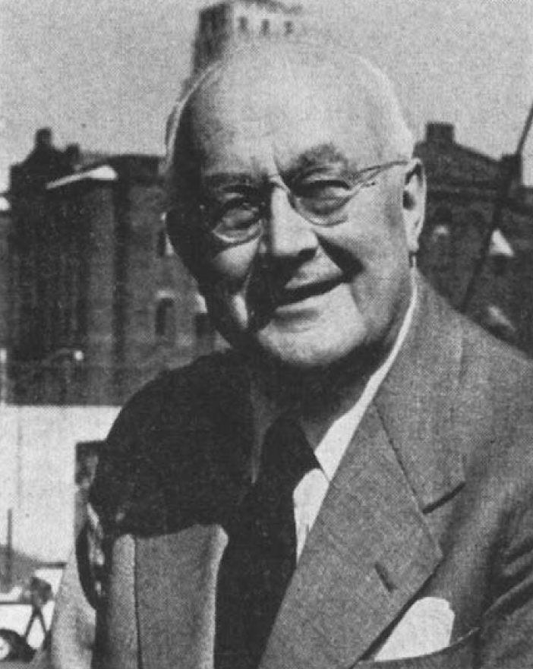
Columbian Carbon Enters the Fray
The Director of Research at Columbian Carbon, Dr. William Weigand is a graduate of Prof. Burton’s group at U. of Toronto
He takes an immediate interest in the new EM

Slide 12
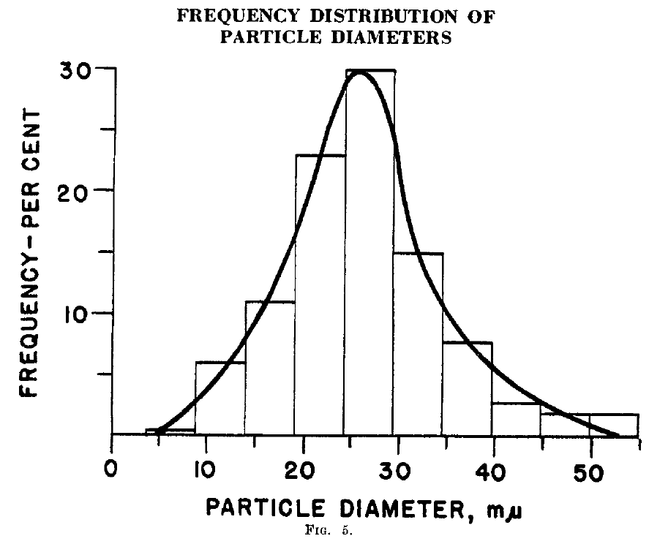
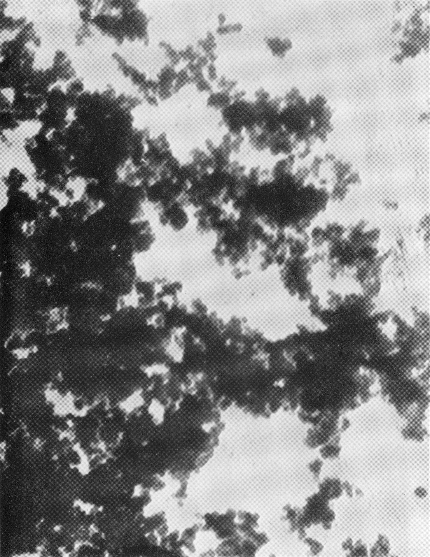
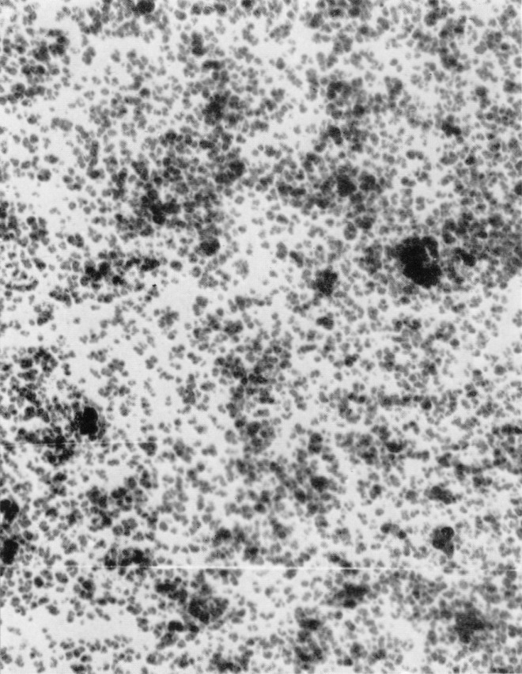
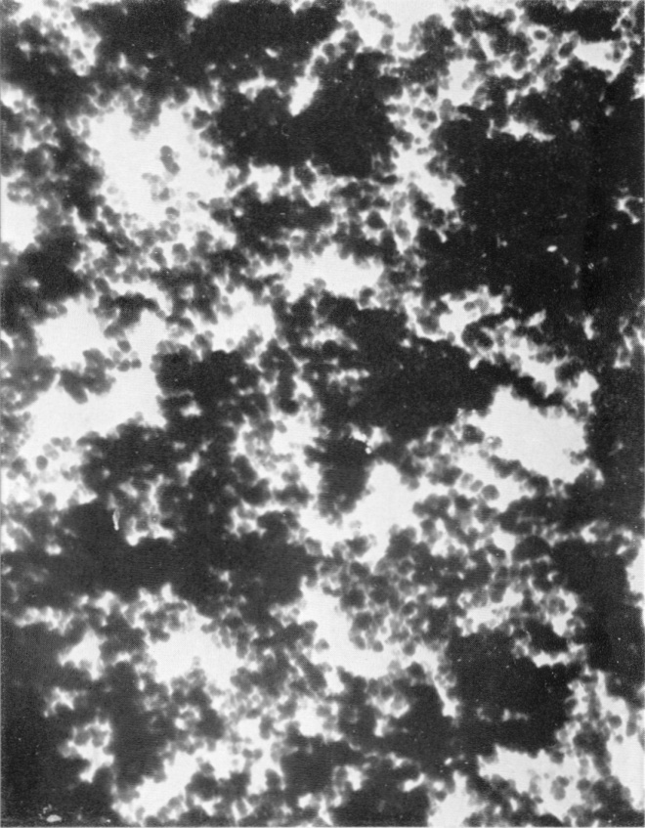
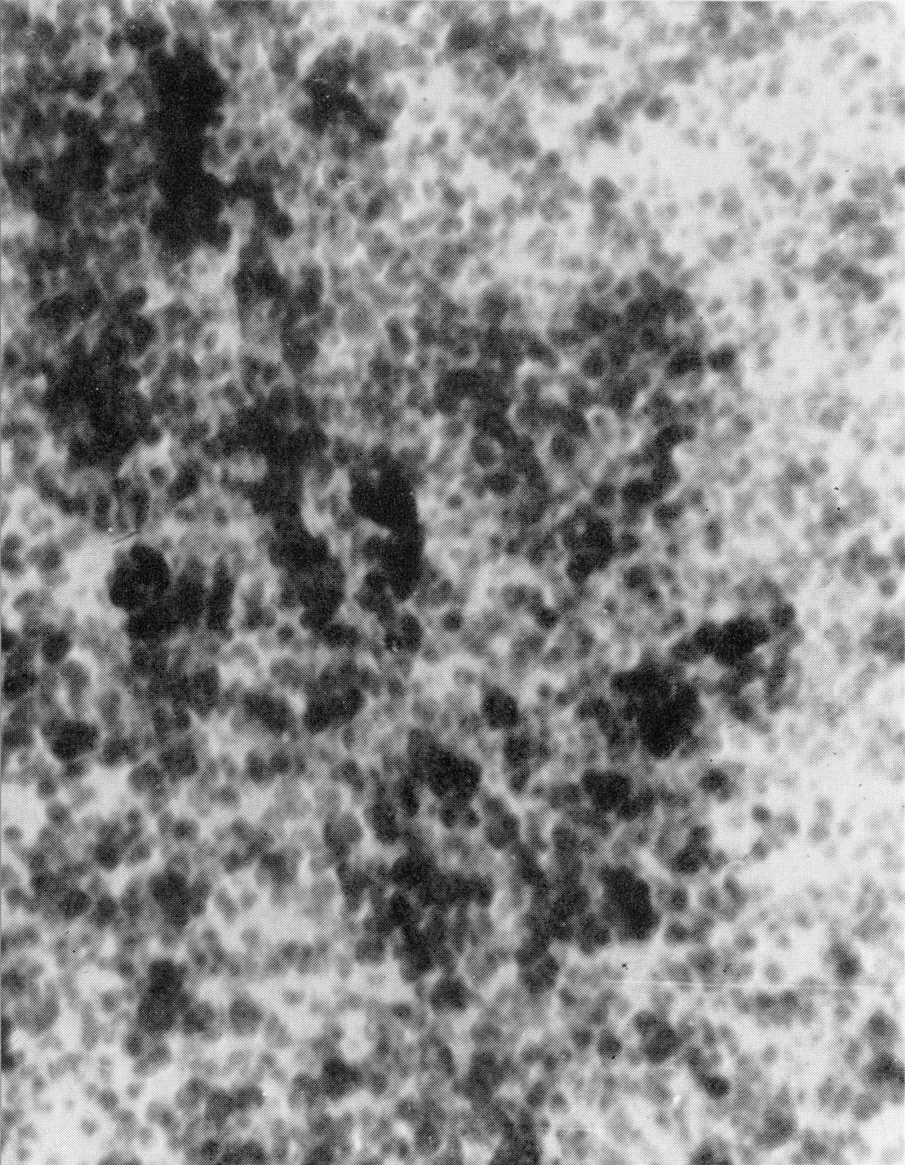
Univ. of Toronto/CCC CB Images
Micronex Colloidal Carbons
Counted 257
Particles
BY HAND!!!
“Wet”
“Dry”
1st TEM micrographs of commercial carbon black,
Acquired in 1939

Slide 13
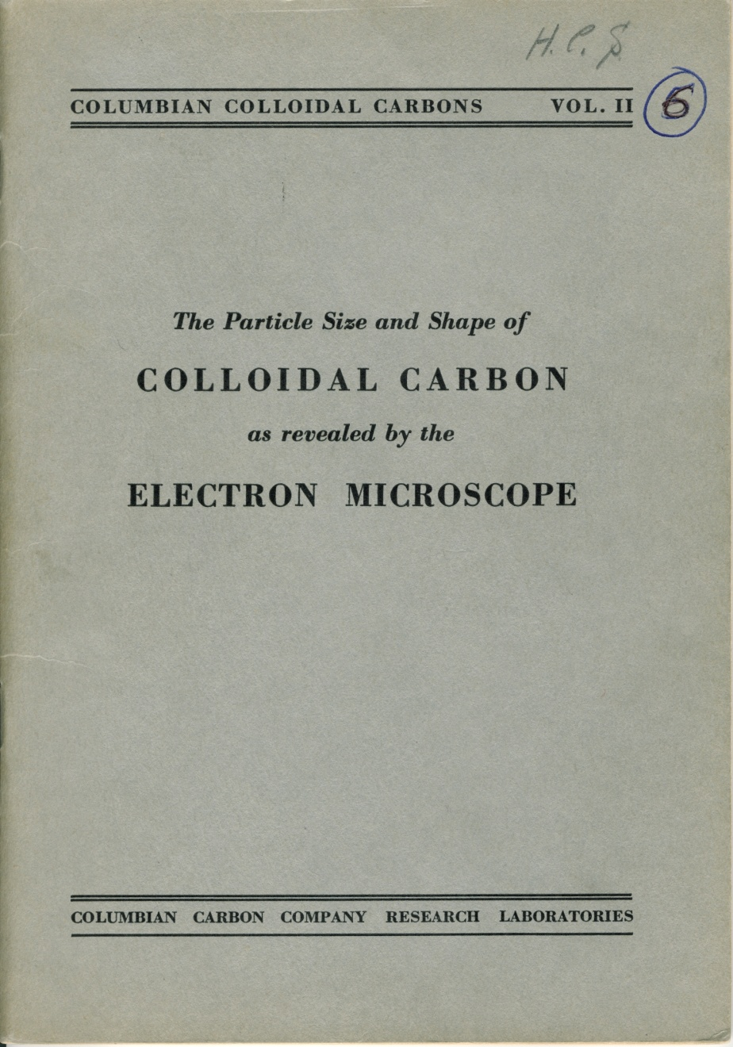
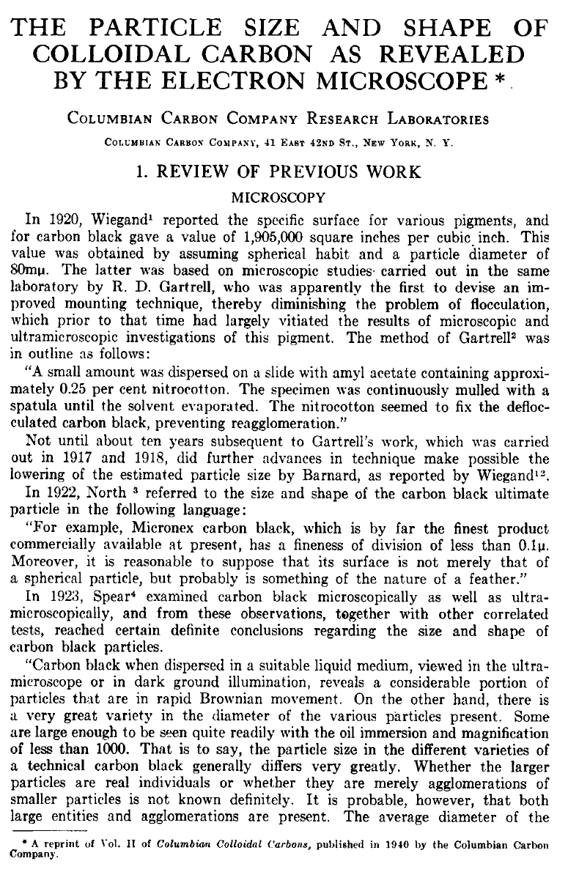
Univ. of Toronto/CCC CB Work
Rubber Chemistry and Technology
Vol. 14, Pg 52, March 1941.
Printed in 1940

Slide 14
CCC’s 1st Electron Microscope
CCC commissions a TEM to be built in 1940
Graduate Student William Ladd builds the microscope at U. of Toronto
He brings it to CCC and accepts a position to run it in 1941

Slide 15
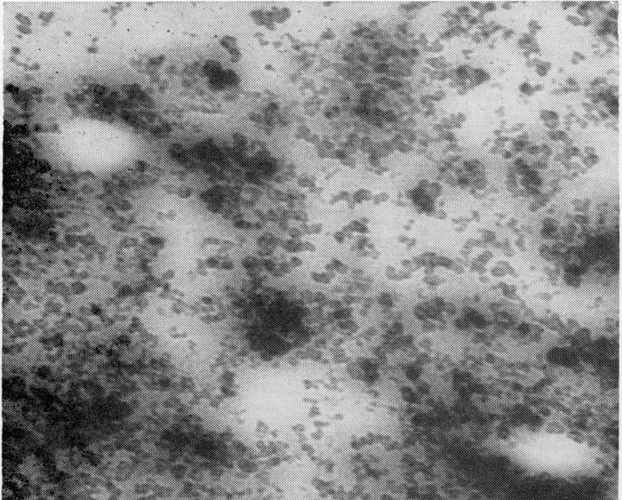
Early EM Work at CCC
Micrograph of well dispersed CB
Micrograph of CB in rubber

Slide 16
CCC and EM Contribute to the War
The United States enters WW II in late 1941 and CCC contributes to the war effort
German tires outperform the Allied tires at the beginning of the war
Pieces of captured German tires are brought to CCC for identification of the carbon black used in the tires
Use the EM to see the morphology

Slide 17
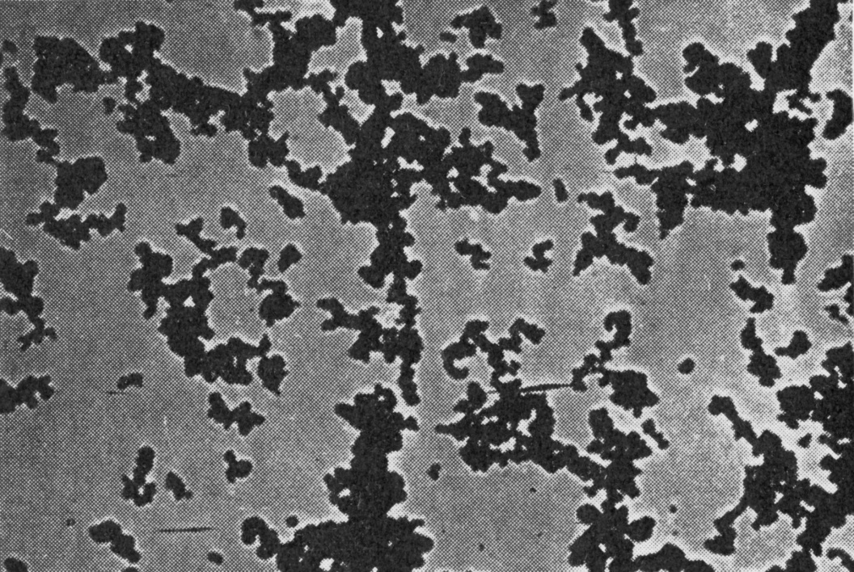
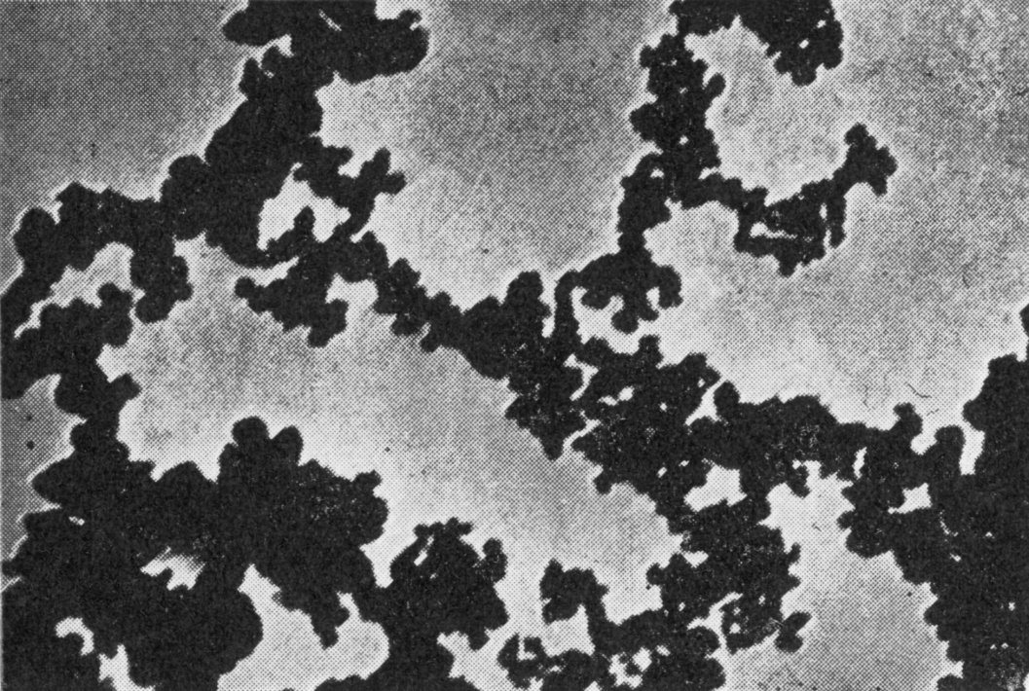
CCC and EM Contribute to the War
The US Navy was having issues with static buildup and sparking of the tires on planes landing on aircraft carriers (BAD!!!!)
EM compared the morphology of regular CB and alternate CBs
Statex 93 – medium structure, low conductivity
Acetylene – high structure, high conductivity
Published under the innocuous title “Recent Developments in Colloidal Carbon” in 1943

Slide 18
CCC’s 2nd TEM
1946 Bill Ladd builds a 2nd microscope for CCC
Incorporates improvements in design and functionality
Remains in service until 1954

Slide 19
Bill Hess Join CCC in 1950
In 1950, William (Bill) Hess joins CCC as a member of the Physics Lab

Slide 20


Bill Ladd Leaves CCC in 1954
In 1954, Bill Ladd leaves CCC to found an electron microscope accessory company
The company eventually becomes Ladd Research Industries and still exists today
Unfortunately, when he leaves CCC, the ability to run his handmade electron microscope goes with him

Slide 21
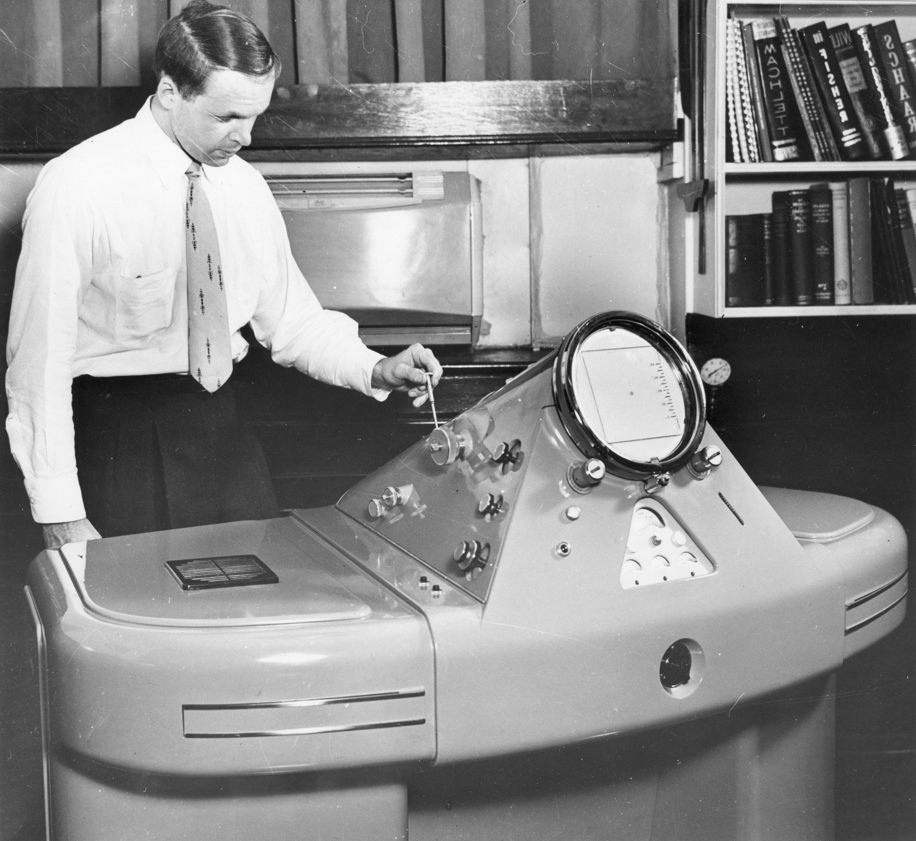
CCC’s First Commercial TEM
Bill Hess becomes the 2nd Microscopy Lab Manager
CCC purchases a Phillips EM100A in 1954
Commercially available instrument
Total cost of $19,000
Buy a 2nd EM100A shortly thereafter
1954

Slide 22

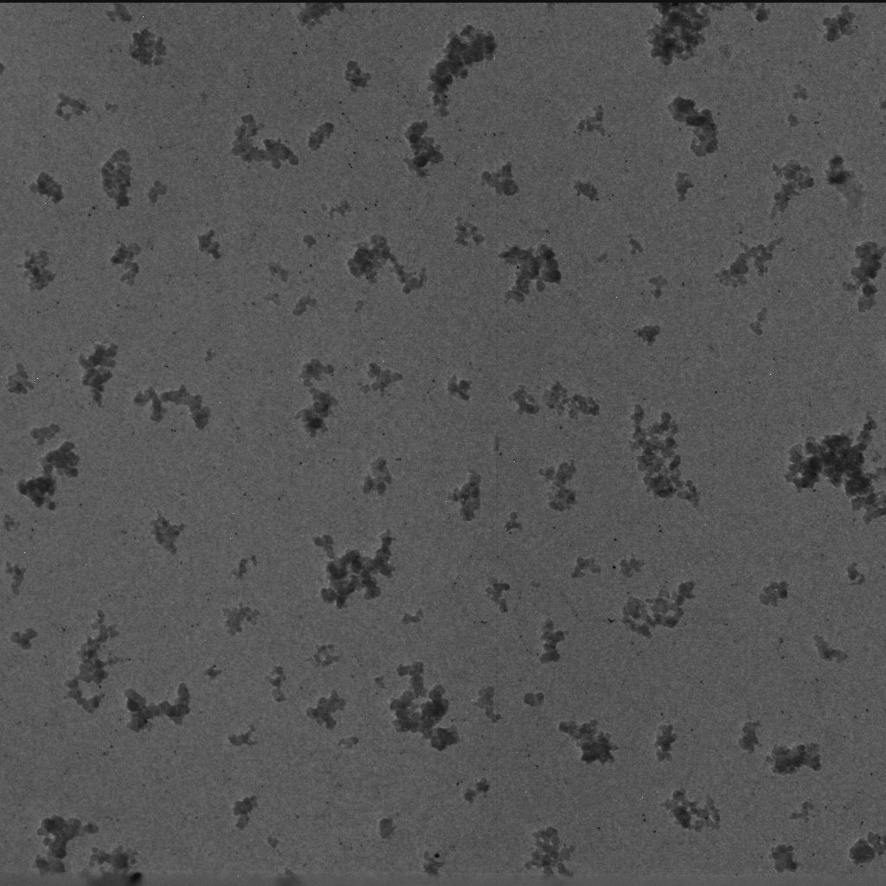


CB Morphology Characterization
First ever EM micrograph was to characterize CB Morphology

Slide 23
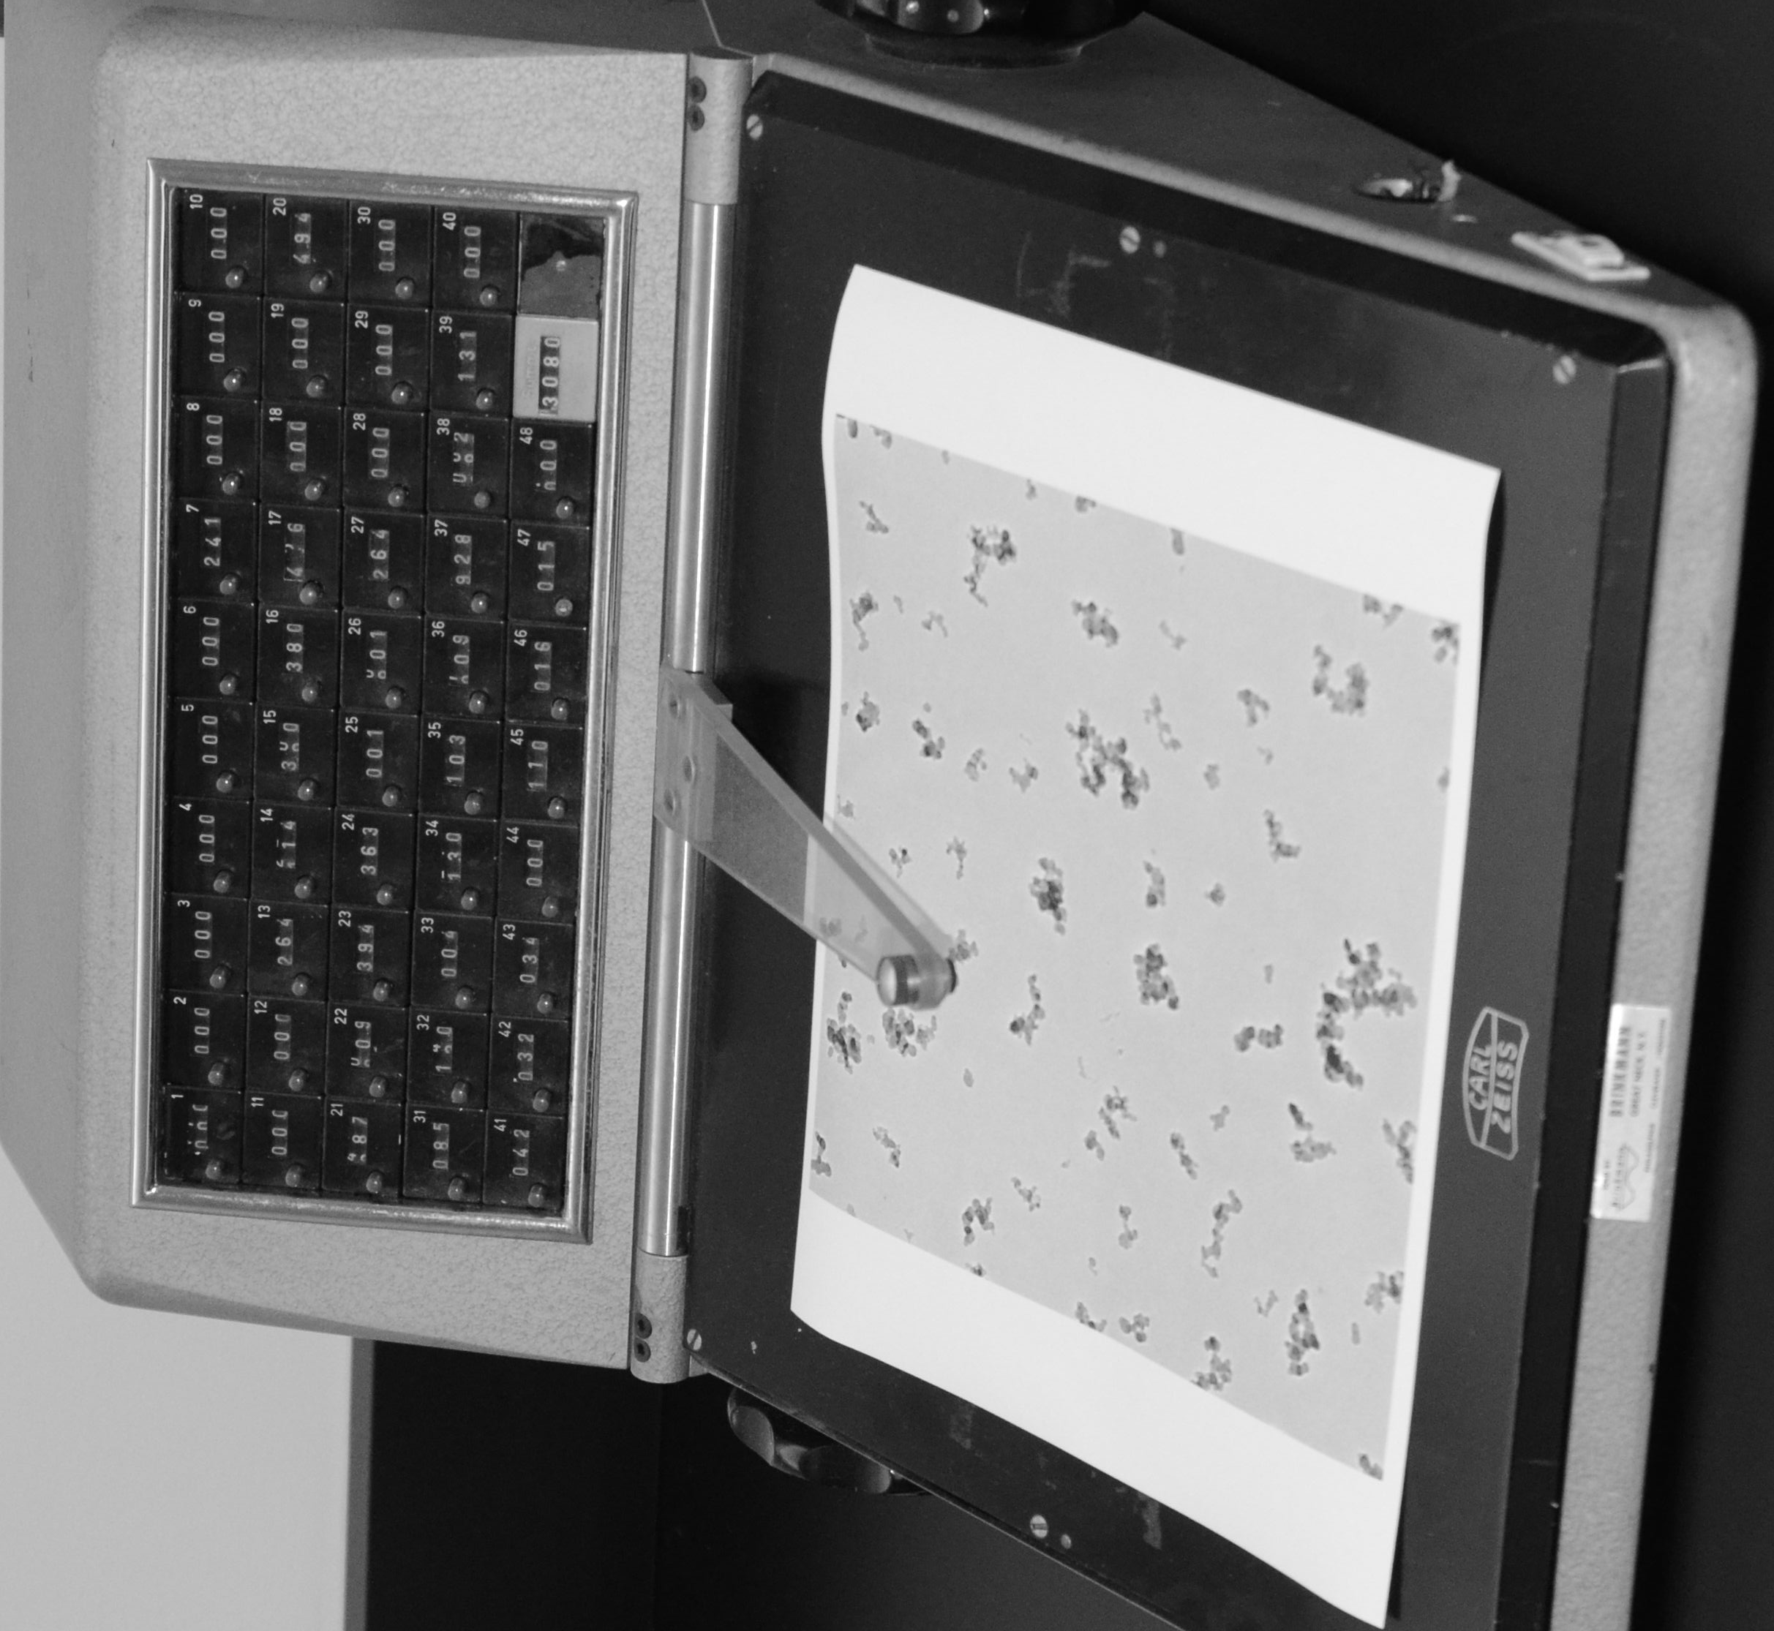
CB Morphology Characterization
Eventually went to “Automated Manual” counter
Operator would sit and count particle size and punch in the size to the tabulator at the top
The machine would do the math, but a human still had to do the analysis
Still, allowed for an understanding of carbon black, and therefore intentional changes of CB morphology

Slide 24
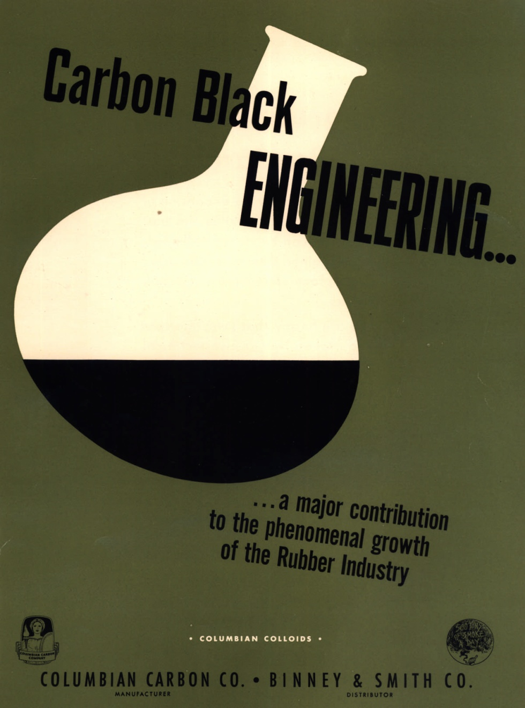
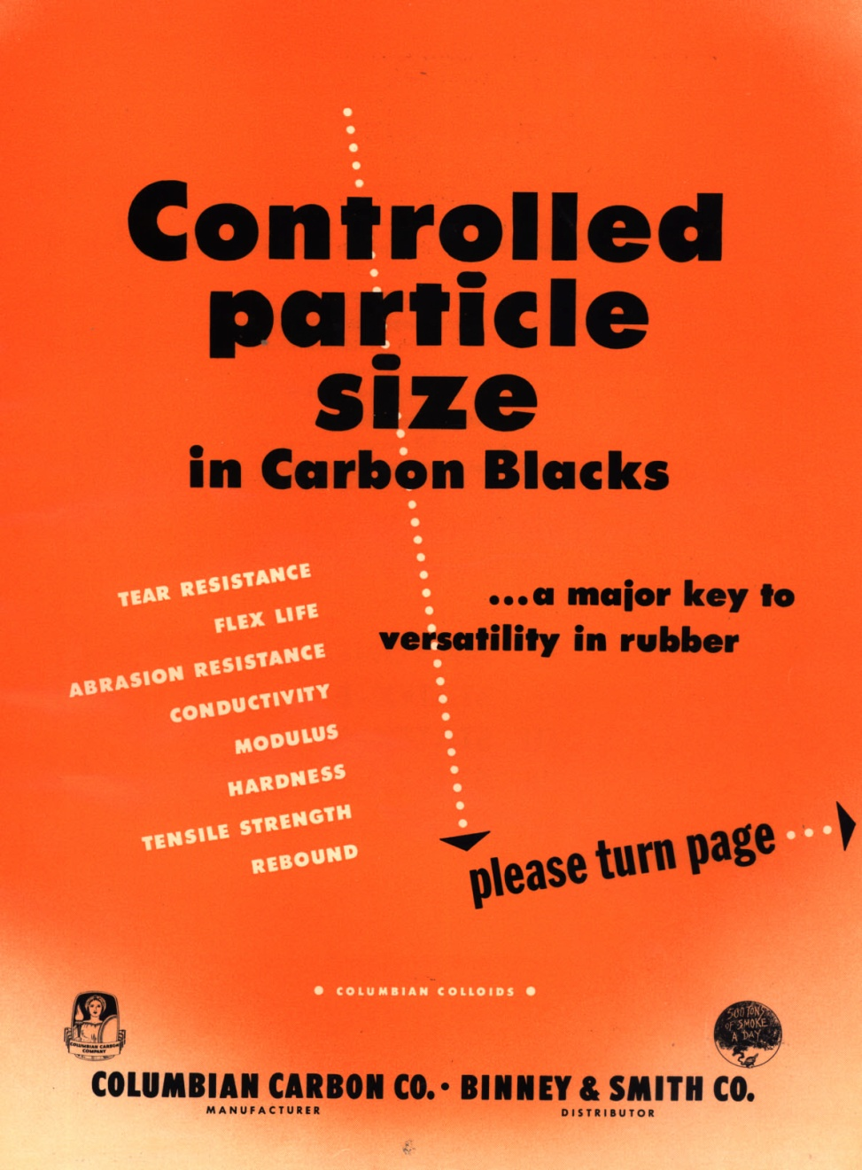

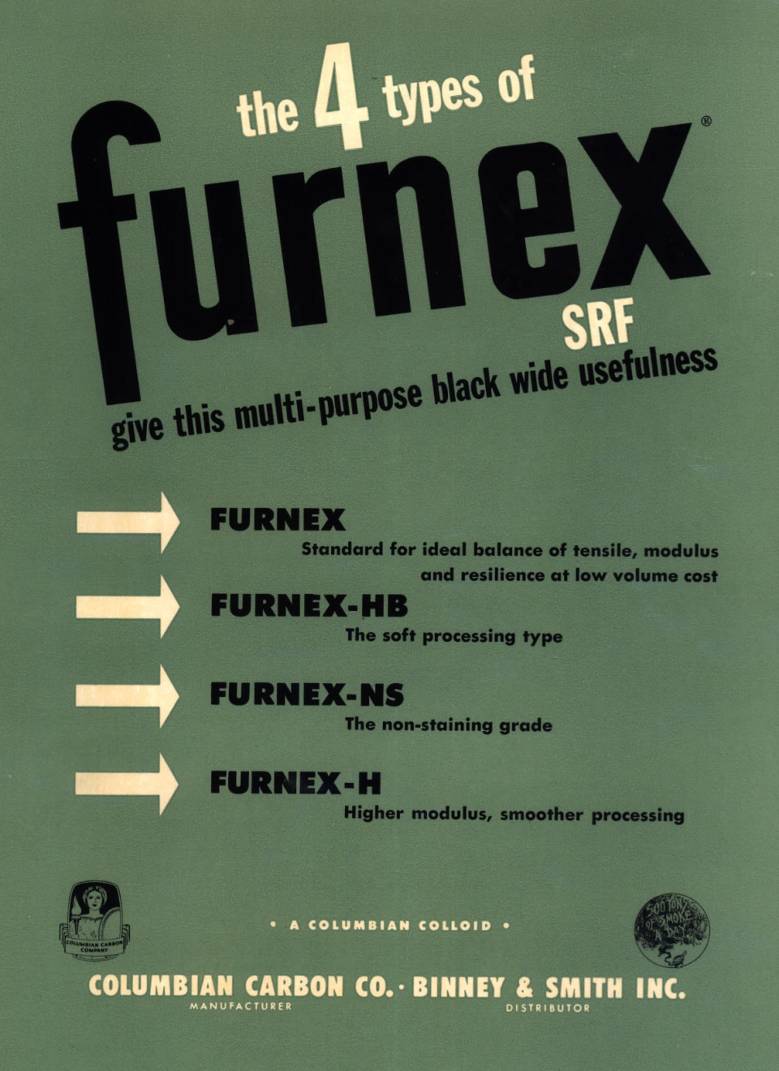
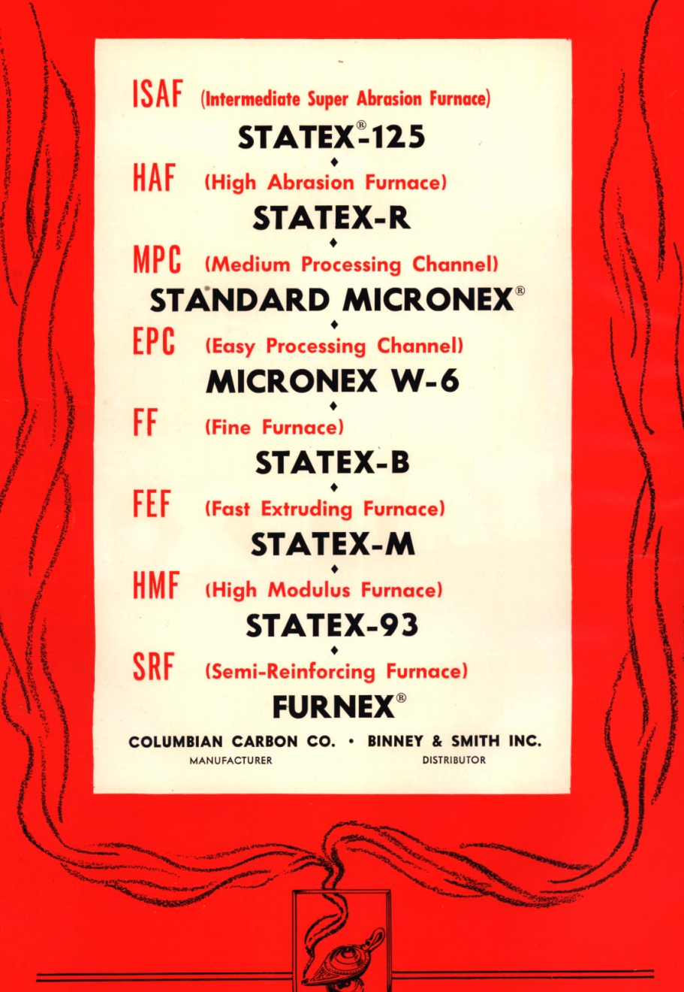
CB Morphology Evolution

Slide 25
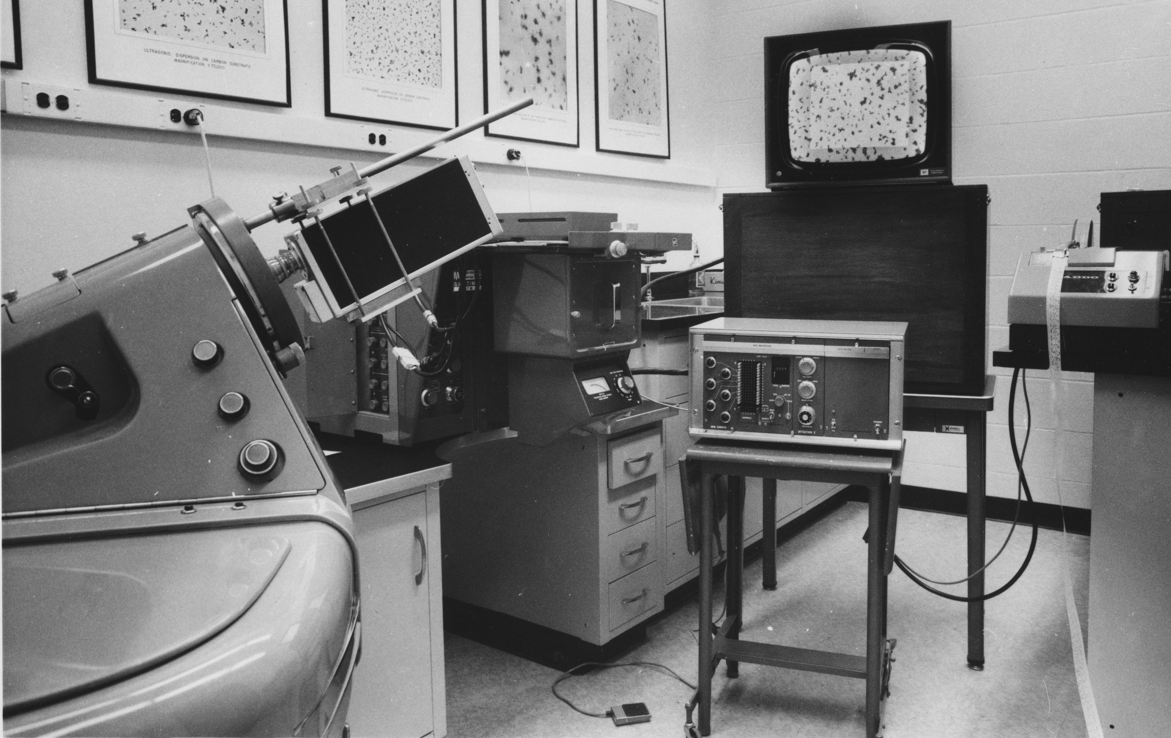
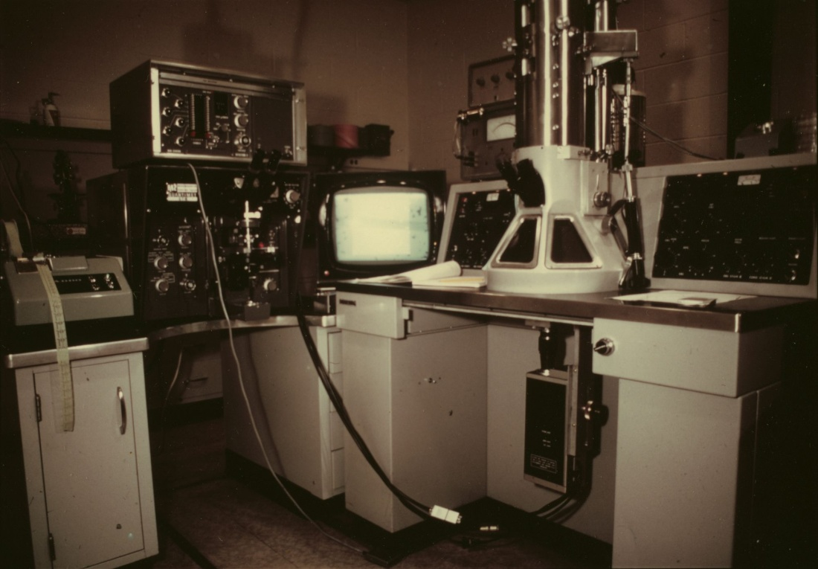
CB Morphology Characterization:
Quantimet
Developed an electronic system to analyze CB morphology (1960’s)
Started by analyzing “cutout” aggregates affixed to a tape
As confidence and computing power increased, started using direct output from the TEM

Slide 26
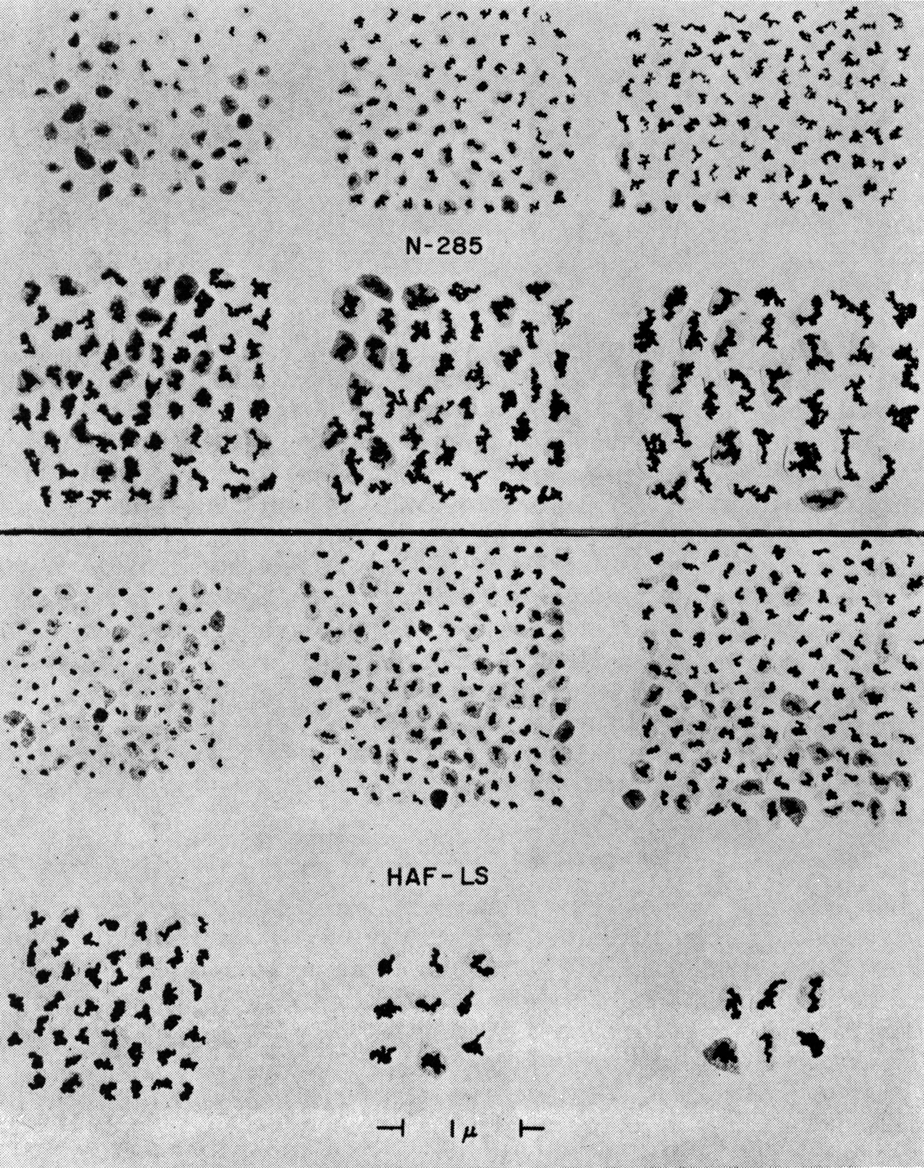
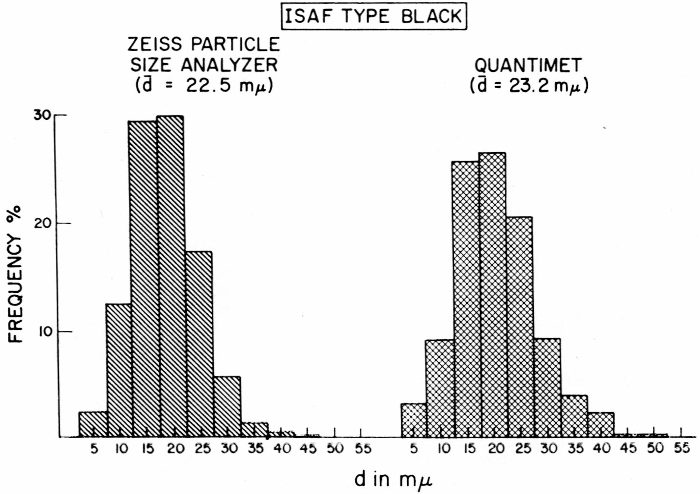
CB Morphology Characterization:
Quantimet

Slide 27
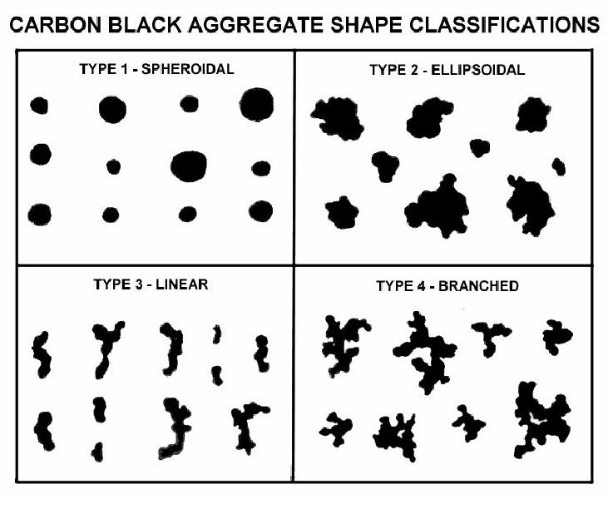
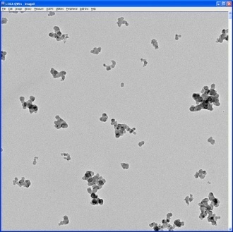
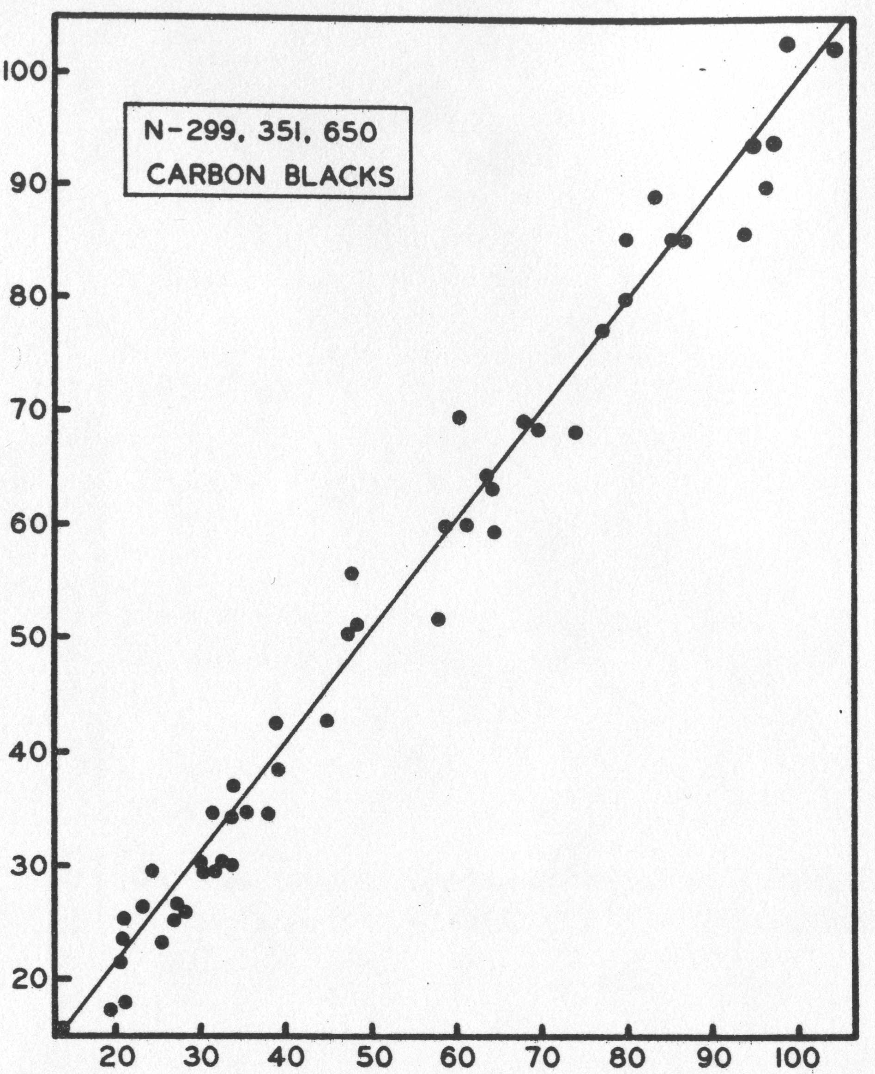
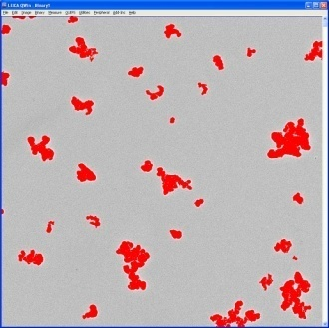
CB Morphology Characterization:
Image Analysis
As computers became more powerful and image analysis more common, switched over from custom equipment

Slide 28
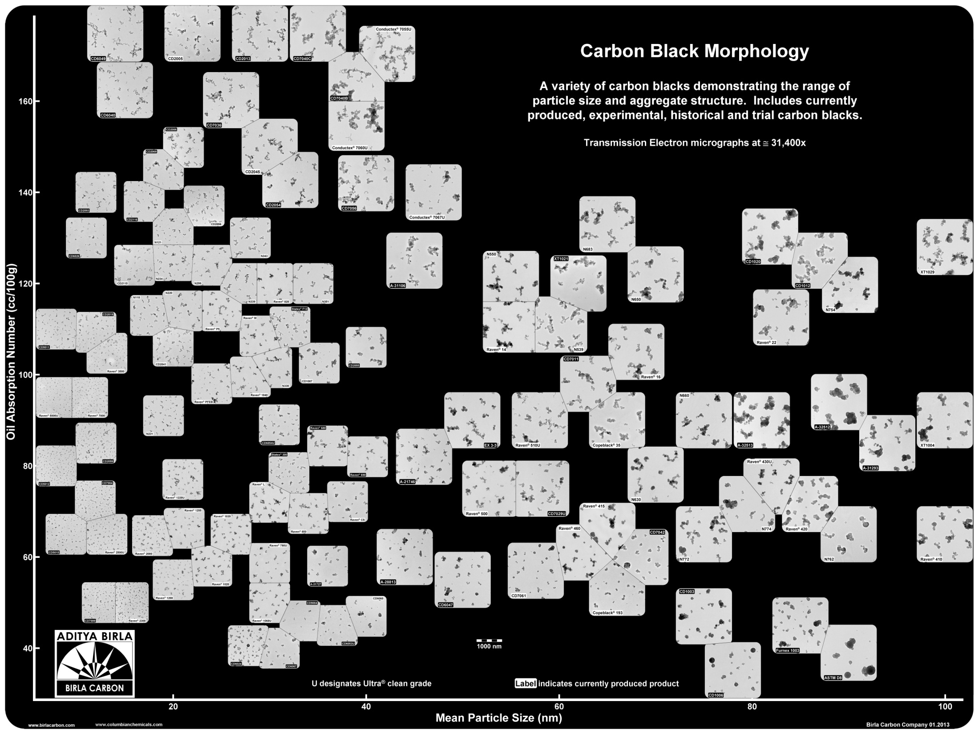
CCC’s TEMs: Current

Slide 29
Conclusion
Have a long and distinguished history in electron microscopy
1st scope in 1941, handmade
14 total electron microscopes over 75 years
Microscopy allowed for “engineering” of carbon black

Slide 30
Microscopy and its Benefit in Understanding Rubber Reinforcement and Structure-Property Relationships for Development of New Products

Slide 31
First, a Perspective from a Former Manager of the “Physics Laboratory”
Five Managers in the history of the Microscopy Laboratory
  Bill Ladd (10+ years)
  Bill Hess (40+ years)
  Charles Herd (10+ years)
  Ricky Magee (10+ years)
  Paul Smith (5+ years)
One person, Bill Hess, is the true founder of the Microscopy Laboratory. He made it what it is today.
As my mentor, I am grateful to Bill and my other managers throughout my career, including Alex Dmytraczenko, Shelby Hare and all co-workers.
Attributes of Bill Hess that made his contribution so great:
  Innate Curiosity and Innovative thinking
  Hardwork, Drive for answers and building a good team around him
  Child-like enthusiasm with science, microscopy, carbon black and rubber reinforcement

Slide 32
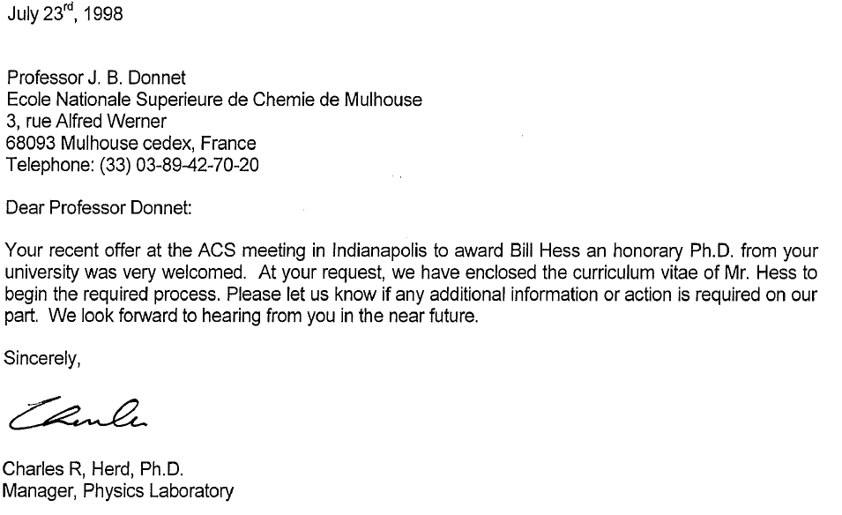
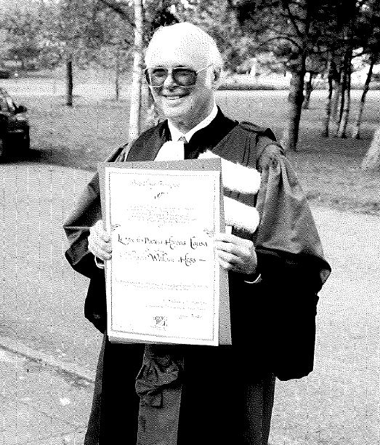
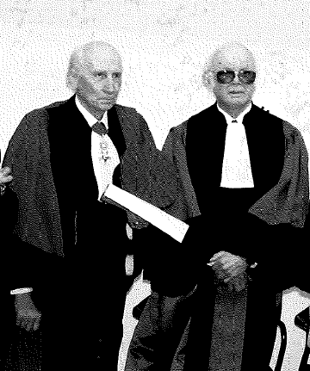
Dr. Bill Hess, Honorary Ph.D. October 27th, 2000. The “Pope” of Carbon Black
Professor JB Donnet (left)
Dr. Bill Hess (right)
l’Universite de Haute-Alsace, Mulhouse, France

Slide 33
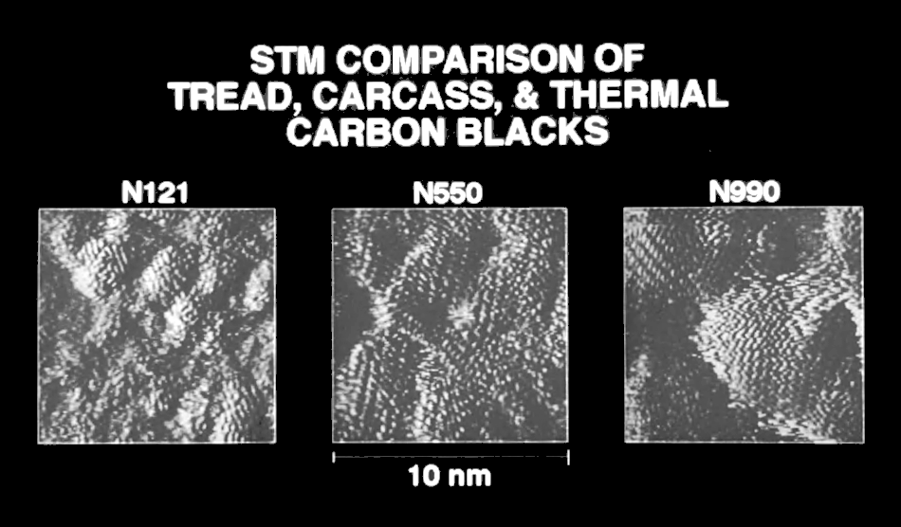
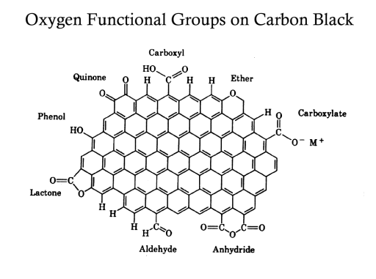
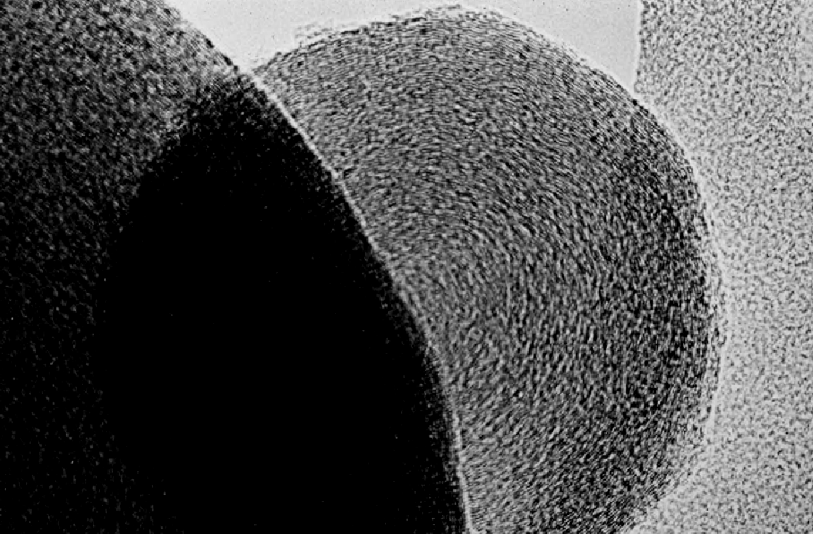
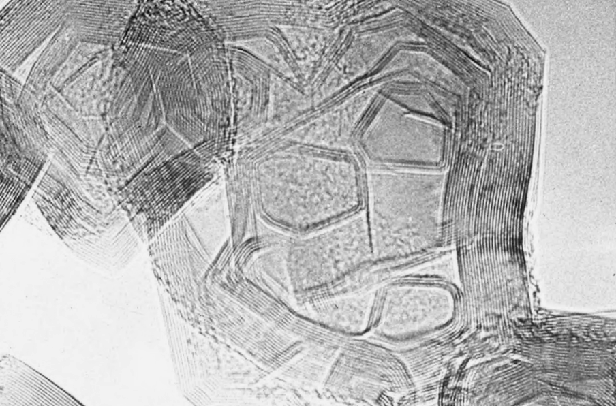
Beyond Colloidal Tests and Leveraging the Fundamental Properties of Carbon Black for Differentiated Performance
“Classical ASTM Colloidal Tests Measure “Bulk” Properties and Consideration of the Fundamental Properties of Carbon Black Must be Addressed to Achieve Differentiated Performance”
Morphology: Particle and Aggregate Size and Shape Distributions
Surface Structure and Surface Chemistry
Microstructural (graphene layers)

Slide 34

Microscopy and its Contribution in Moving Carbon Black Technology Forward
Laboratory data is used for iterative feedback in New Product Development.
Microscopy has played a key role in understanding the fundamental properties of carbon black and how it manifests itself in rubber, plastics, and inks and coatings.
Microscopy and Surface Analysis play a key role in understanding today’s carbon black for the new products of tomorrow.
Baseline Current Carbon Black Technology: ASD, PSD, Surface Activity
Baseline Current In-Rubber Performance
Ideation and Produce New Carbon Black
Characterize and Evaluate In-Rubber
RCB Technology and Product Development

Slide 35
Microscopy and its Contribution in Moving Carbon Black Technology Forward
Surface-Modified Carbon-Black Polymer Phase Distribution and Carbon Black Networking.
Carbon Black Aggregate Size and Shape Distribution for Reduced CB Networking.
Tomographic Reconstruction for Carbon Black Volume Determination and Optimized Aggregate Mass Distribution and Inter-aggregate Spacing in a Rubber Compound (volume).
All studies geared toward Development of Low Rolling Resistance Tires for Improved Fuel Economy and Sustainability
RCB Technology and Product Development

Slide 36
Surface-Modified Carbon-Black Polymer Phase Distribution and Carbon Black Networking

Slide 37


Summary of Breakthrough Technology
“The reactive in-situ mixing of a Surface-Modified-Carbon-Black with In-chain and Along Chain functionalized SSBR’s can match silica performance while providing process and cost benefits, thereby shifting the Tire Performance Triangle paradigm to a Tire Performance Quadrangle”.
RR
RR
Processing and
Compound Cost
N234/ SSBR
Silica/SSBR
SM-CB with
Fxn SSBR
Treadwear
Treadwear
Wet Traction
Wet Traction
*Note: Higher or Outward Pointing Arrow Indicates Better Performance,
whether it is RR, Wet Traction , Treadwear, or Cost
WO 2011/028337 A2

Slide 38
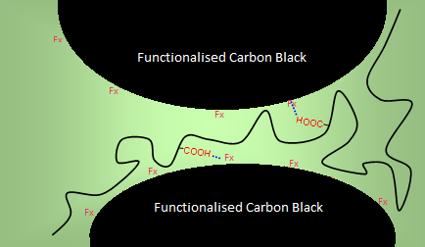
Introduction of Breakthrough Technology: Significantly Improved SM-CB-Elastomer Interaction For Low Rolling Resistance Tires
Interaction between SM-CB
and functionalized SSBR results in:
better filler dispersion
reduced filler network
lower rolling resistance
SM-CB
Reactive in-situ mixing of surface modified carbon black (SM-CB) in combination with functionalized SSBR (Along and Chain-End Fxn.):
Results in Significantly Reduced Payne Effect and tan delta / rolling resistance
N234 + standard S-SBR
SM-CB
SM-CB +COOH-fxn. S-SBR
Indian Rubber Institute

Slide 39
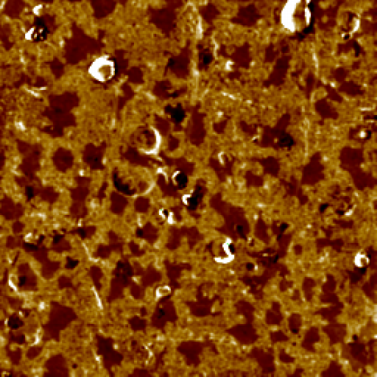
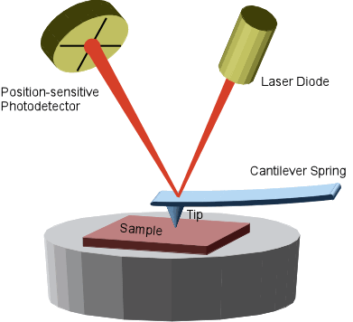
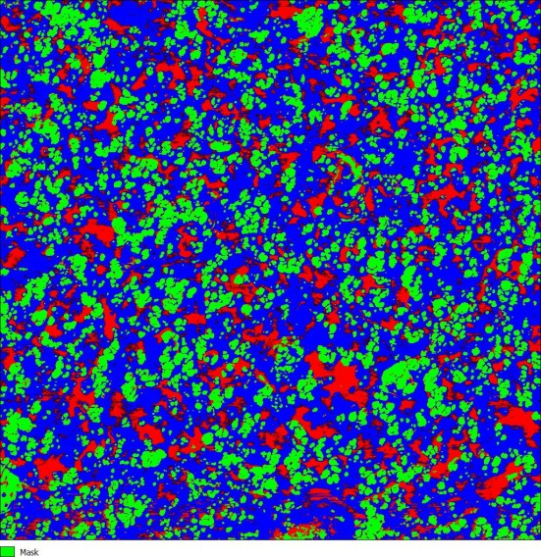
Atomic Force Microscopy Analysis of Rubber Compounds for Carbon Black Phase Distribution
A sharp probe (<20 nm) rasters across the surface to monitor topographical and mechanical properties of the rubber cross-section
Phase Image
“Pure Gum” 70/30 SBR/BR Blend
BR
SSBR
5 μm
Preblend 70/30 SM-CB/N234
Blue=Fxn-SSBR
Red=BR
Green=SM-CB and N234
http://www3.physik.uni-greifswald.de/method/afm/eafm.htm

Slide 40
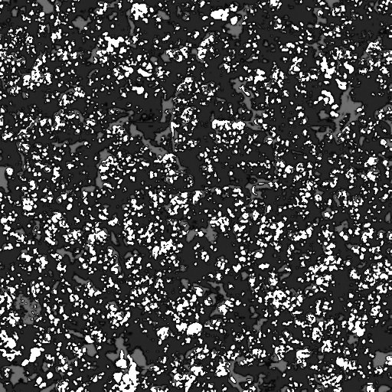

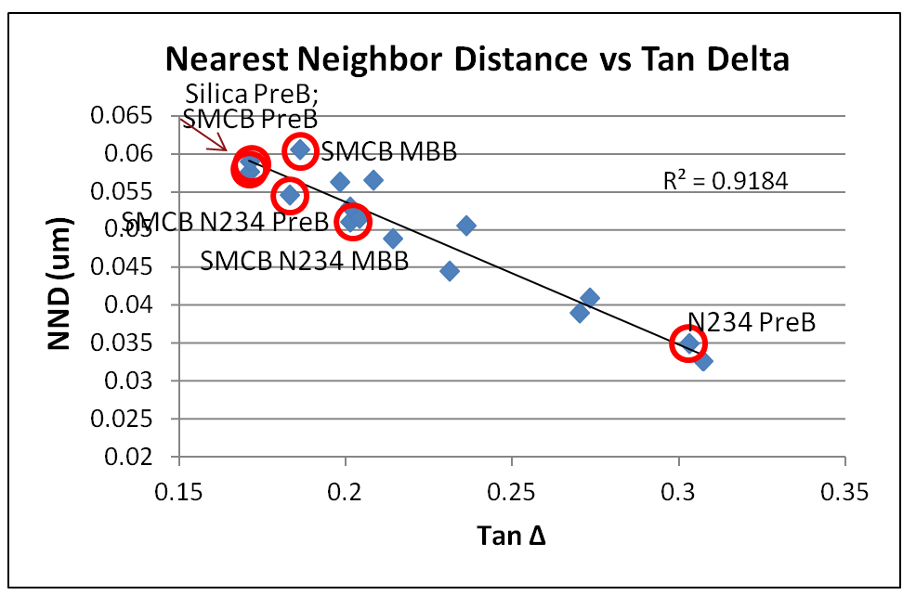
Quantification of Carbon Black Microdispersion (Network) in Phase Distribution Mixes by AFM
The degree of carbon black networking, in a quantitative manner, can be assumed to be represented by the individual “aggregates/agglomerates” measured in the binary, AFM image.
The nearest neighbor distances of these aggregates/agglomerates may serve as a quantitative measurement of the carbon black microdispersion / network.
Correlation of this parameter to dynamic properties related to carbon black networking, (Delta G’ and tan delta) is useful as confirmation of the network measurement.

Slide 41
Tomographic Reconstruction for Carbon Black Volume Determination and Optimized Aggregate Mass Distribution and Inter-aggregate Spacing in a Rubber Compound (volume)

Slide 42
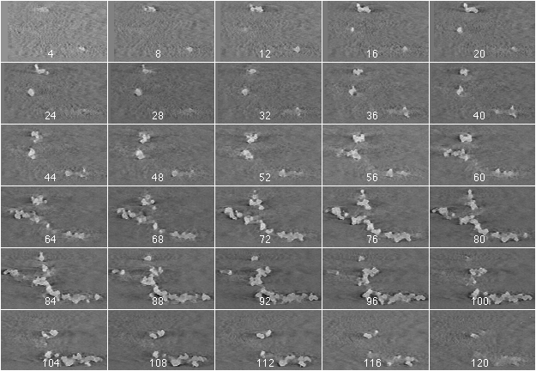
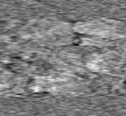
CB Aggregate Volume “Cut” in Nanometer Thick Slices
±78°, 6° increments
single tilt axis
Philips Tecnai F20
Notes:
This is a montage (movie) of a branched aggregate. Note that the linear spine of this aggregate is lying in the X,Y plane but that other branches, most notably the one near the top of the aggregate extends a significant amount toward the viewer in the Z direction - something that would not bee seen in a 2-D projection...

Slide 43
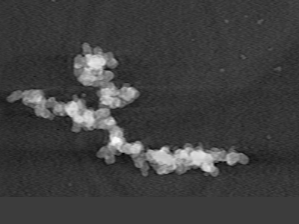
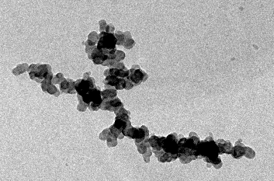
Tomographic Reconstruction for Measuring the Volume of Individual Anisotropic Aggregates
0° TEM image
0° Projection of Volume
Volume = 359030 voxels = 1.2 x 10⁷ nm³
Area = 176014 pixels = 1.8 x 10⁶ nm²
Surface Area = 83 m²/g
2D volume = 349335 vox (3% difference)
Notes:
This is the zero degree TEM image of this aggregate and a simulated zero degree TEM image of the reconstructed volume
The 2D volume calculation of even this complex aggregate is only 3% smaller than that found from the 3D model. These comparisons with 2D measurements are reassuring and show that the technique is in the correct range of values.
Again, THIS FIGURE CAN NOT BE USED TO IDENTIFY THE GRADE AS A WHOLE BECAUSE IT IS FOR THIS AGGREGATE ONLY. However, it can be used to show that the measured volume and area are, at the very least, of an appropriate order of magnitude.

Slide 44
Closing Remarks
The Microscopy Laboratory has served as a differentiator for Birla Carbon for many decades and has given tremendous insight into carbon black itself and related materials for elucidating structure property relationships.
In fact, the entire laboratory and process engineering groups have contributed greatly to this mission and the support of all scientist has made Birla Carbon Technology what it is today.
Our company has supplied us with a tremendous “playground” for our scientist, and we should be humbled each day we enter the headquarters and laboratory that we have such an awesome facility and equipment to use for our imagination and innovation. Creating the future is up to us.

Slide 45
My Chapter - Magee
Bill Hess – personal reflection
My role in this history (2000 – 2010)
  Practical Applications
    Fugitive Emissions
    Complaint Resolution/Claim Mitigation
    Competitive Blockade (ASTM D3849)
SEM – Tool of propulsion (comments only)

Slide 46

View from Downtown Hamilton, Ontario
Steel Mill
Coke Oven
Notes:
As previously mentioned, steel mills are a common source of soot like particulates that resemble carbon black. This picture was taken from atop the Sheraton Hotel in Hamilton, Ontario. You can see the black plume from the coke oven. Columbian’s carbon black plant is ~ 3 miles away. One of our production superintendents lives within a few blocks of the steel mill, yet when he noticed a dusting of black material on his car one morning, he was certain that it was carbon black. He collected some of the material from his car for evaluation at CCC’s technology lab, and after checking with the carbon black plant noted that there were no process upsets that would have resulted in a release, furthermore, the meteorology measurements showed the wind was blowing from the superintendents house toward the plant.

Slide 47


Transmission Electron Micrographs
Soot from Coke Oven
Carbon Black
Carbon = 97.4 %
Oxygen = 2.3 %
Sulfur = 0.3 %
Carbon = 99.4 %
Oxygen = 0.4 %
Sulfur = 0.2 %
Notes:
A TEM micrograph of the soot from the coke oven shows its general morphology is similar to carbon black; however, the elemental composition confirms soot. Generally speaking, carbon black will be ~99% C with less than 1% O. This work was done on a high resolution TEM with EDX spectroscopy and a highly trained operator to differentiate between these materials. I think it is safe to assume that this work could not be done with a light microscope. However, to further demonstrate and document the fact that TEM is required for identifying the presence or absence of carbon black in environmental dust, I offer the following example.

Slide 48

PolyOne Hickok N650U Claim
Excerpt from Lab Report:

Slide 49

Carbon Black Meets Expectations

Slide 50


TEM to the Rescue

Slide 51
Complaint Summary
Compound contaminated with N330
Hickok cannot make this type of CB
Hickok Railcars – contamination not possible
Other CB used by Customer – N330
No claim paid or carbon black returned
10 Years Later. . .

Slide 52
TEM – Not Good for Specifications
Particle size – how is it measured at plant.
MPS Spec. for UV Applications.
The current ASTM Method (D3849) was not capable of accurate quantitative measurements between companies.

Slide 53


Measuring CB Morphology is Hard Work
D3849 in 2008
Where we want to be.

Slide 54

A Better TEM Method Possible
We can rebuild him. We have the technology. We can make him better than he was. Better, stronger, faster.

Slide 55
A Better TEM Method
Strongly Opposed
Major competitor strongly opposed to modifications and improvement to the TEM standard
Blocked all attempts to improve method
Even brought lawyers to the ASTM Meeting (a first)

Slide 56

Commercial Issue –
Why Did Cabot Fight So Hard?
Costs
  N300 carbon black costs ~11% less to produce than N200
Dispersion
  Coarser carbon blacks easier to disperse
Hard to detect performance difference
over short time range
Blocks out honest competitors (BC)

Slide 57




ASTM Standard Revised 2014
No TEM Required for MPS Certification

Slide 58



Slide 59
Closing Remarks
Tools not Toys
  Solving today’s problems
  Developing tomorrow’s solutions
Management Support
Lab Tour Details

